Slide 1
July 2018
Cognizant COSMOS
Microservices Design and Delivery using Open Standards
Cognizant Digital Engineering

Slide 2
Microservices Architecture Implementation Challenges that COSMOS Helps Solve
What are the typical microservices implementation challenges?
Developer Learning Curve
Enforce Uniform Coding Standards
Reuse Common Libraries
Support Interchangeable Infrastructure Components
Automated Deployment Pipeline
Notes:
The key drivers for creating this accelerator came from our analysis of some of the more common implementation challenges that we took note of from our microservices projects
Bringing developers within business verticals up to speed with the microservice constructs, components and nuances
With large number of microservices being developed across development centers over different geographies, how do we enforce uniform coding standards

Slide 3






Cognizant COSMOS – Microservices Design and Delivery Accelerator
Architecture Guidance
Framework
Foundational Libraries
& Services
Developer Studio
Reference Architecture:
A technology and vendor neutral reference architecture that embodies the comprehensive capabilities required for implementing microservices
Reusable Patterns & Services:
Offers configurable templates embodying the common service design patterns and a suite of reusable helper components for interaction between services and other governance and infra components
API Modeler:
Generates code scaffold for microservices with generic method bodies and their data models using an intuitive graphical API Modeler for RESTful services
Technology Architecture:
A technology architecture that offers various technology options for implementing the components of the reference architecture
Multiple Implementation Options:
The various components that define the microservices reference architecture can be implemented using a variety of technology options
Framework Approach:
Offers a framework approach to microservices development by abstracting architectural best practices and common design constructs to a set of common libraries, which may be imported as dependencies into any microservice project
Reference Implementation:
Enforces uniform coding standards and code consistency by providing a reference implementation that may be used as archetypes to develop new services using synch, asynch and reactive technologies
Multiple Deployment Options:
Supports deployment to bare-metal virtual machines as well as Platform-as-a-Service environments - Pivotal Cloud Foundry, Red Hat OpenShift and Amazon Web Services (AWS)

Slide 4
Microservices Architecture Reference Architecture
IDENTITY
MONITORING
RESILIENCY DASHBOARD
LOG ANALYSIS DASHBOARD
SERVICE HEALTH
MONITORING DASHBOARD
APPLICATION MONITORING DASHBOARD
PERFORMANCE & TRACING DASHBOARD
API
STORE
API
MANAGER
DISCOVERY
SERVICE
CONFIGURATION
SERVICE
WORKFLOW
SERVICE
NOTIFICATION
SERVICE
ORCHESTRATION
SERVICE
ADMIN
CONSOLE
MICROSERVICES CONTAINER n
MICROSERVICES CONTAINER 1
MICROSERVICES CONTAINER n
MICROSERVICES CONTAINER n
API GATEWAY
ROUTING SERVICE
EXECUTION
FRAMEWORK
INTEGRATION
FRAMEWORK
EXECUTION
FRAMEWORK
INTEGRATION
FRAMEWORK
DB
DB
CLIENT LIBRARIES
CLIENT LIBRARIES
DISTRIBUTED CACHE
MESSAGE BROKER
DEPLOYMENT ENVIRONMENT (ON-PREMISE, IAAS, PAAS)
DESIGN TIME ENVIRONMENT

Slide 5
Cognizant COSMOS Reference Implementation
Demonstration

Slide 6

Reference Implementation – Use Case
COMPOSITE SERVICES
CORE SERVICES
LB = Load Balancer
CB = Circuit Breaker
MC = Microservices Container
IC = Integration Component
MC
MC
SCHEDULE
IC
ROUTING SERVICE
MC
FLIGHT
IC
FLIGHT-INFO
MC
AIRCRAFT
LB/CB
IC
MC
AIRPORT
IC
API STORE
API GATEWAY
MC
AIRLINE
IC
LDAP
DISCOVERY SERVICE
MONITORING
DASHBOARD
CONFIGURATION SERVICE
LOG ANALYSIS DASHBOARD

Slide 7
Thank You

Slide 8
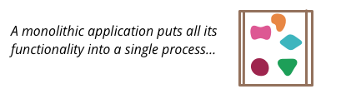
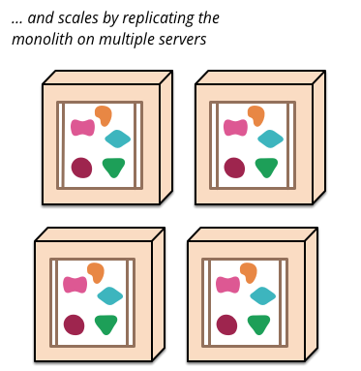
Microservices Architecture Definition
(Source: http://martinfowler.com/articles/microservices.html)
Notes:
Monolith Architecture Characteristics [One build and deployment unit, One code base, One technology stack]
Benefits Simple to develop , Simple to test , Simple to deploy ,Simple to scale horizontally by running multiple copies behind a load balancer.
Problems
Huge and intimidating code base for developers
Development tools get overburdened [Refactoring take minutes, Builds take hours, Testing in continuous integration takes days]
Scaling is limited [Running a copy of the whole system is resource-intensive, It doesn’t scale with the data volume out-of-the-box]
Deployment frequency is limited [Re-deploying means halting the whole system, Re-deployments will fail and increase the perceived risk of deployment]
Monolith Layered System Architecture Presentation-Logic-Data Access-Database
Problems
Still huge codebases (one per layer)
… with the same impact on development, building, and deployment
Scaling works better, but still limited
Staff growth is limited: roughly speaking, one team per layer works well
Developers become specialists on their layer
Communication between teams is biased by layer experience (or lack thereof)

Slide 9
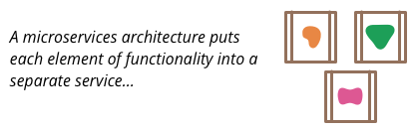
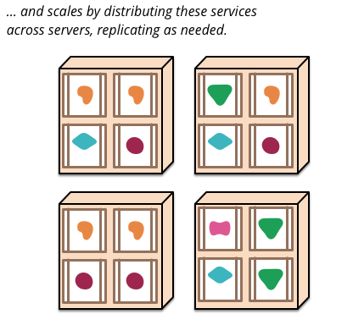
Microservices Architecture Definition
(Source: http://martinfowler.com/articles/microservices.html)
Notes:
Each Microservice is functionally complete
Each Microservice handles one resource
Each Microservice deployed independently
Benefits
Independent codebase
Independent technology stack
Independent scaling
Independent evolution of features

Slide 10
Microservices Architecture Impact
What will happen in a system landscape when we start to split up a few monolithic applications and replace them with a large number of microservices?
Larger Service
Count
Fast-Changing System Landscape
Remote Service Communication
Larger Attack
Surface
Frequent Service Failures
Notes:
Larger Service Count
A larger number of independently deployed services increases
operational complexity. This shifts complexity from the application
developers to the operations team.
Fast-Changing System Landscape
The system landscape is very dynamic, with services redeployed,
replaced, deprecated and spawned on a continuous basis.
Remote Service Communication
Services communicate remotely with one another. Remote calls
impact service performance and increase chattiness.
Larger Attack Surface
Modularity limits the privileges an attacker gets in a single attack.
But it also increases the attack surface, as more services are
exposed to the external world.
Frequent Service Failures
Higher-service modularity and remote calls increase the risk of
failures while reducing the failure complexity and resolution time.

Slide 11
Microservices Architecture Considerations
This will result in a number of important and (in some cases) new runtime related questions:
How are all our microservices configured and is it correct?
How do we keep up with the routing information?
How do we verify that all our services are up and running?
How do we ensure that only the relevant services are exposed externally?
What microservices are deployed and where?
How do we prevent a chain of failures?
How do we track messages that flow between services?
How do we secure these services?

Slide 12
Microservices Architecture Capabilities Required
This will result in a number of important and (in some cases) new runtime related questions:
How are all our microservices configured and is it correct?
How do we keep up with the routing information?
How do we verify that all our services are up and running?
How do we ensure that only the relevant services are exposed externally?
Centralized Configuration Management
Dynamic Routing and Load Balancing
Resiliency Dashboard for System Heath and Service Usage
Edge Server and API Gateway
What microservices are deployed and where?
How do we prevent a chain of failures?
How do we track messages that flow between services?
How do we secure these services?
Service Self-Registration and Discovery
Circuit Breaker
Centralized Log Analysis and Call Tracing
OAuth2.0 and Other Security Protocols

Slide 13
Microservices Architecture Technology Architecture
IDENTITY
MONITORING
HYSTRIX TURBINE
ELASTICSEARCH, LOGSTASH, KIBANA
CONSUL, EUREKA, KUBERNETES, OPENSHIFT
PROMETHEUS, GRAFANA, KUBERNETES, OPENSHIFT
ZIPKIN
API
STORE
API
MANAGER
CONSUL, EUREKA, KUBERNETES
ARCHAIUS
ACTIVITI
CUSTOM
SPRING BOOT APP
CONDUCTOR
SPRING
BOOT APP
MICROSERVICES CONTAINER n
MICROSERVICES CONTAINER 1
MICROSERVICES CONTAINER n
MICROSERVICES CONTAINER n
API GATEWAY
ZULL
APACHE CAMEL
SPRING BOOT
APACHE CAMEL
SPRING BOOT
MYSQL
MYSQL
CLIENT LIBRARIES
CLIENT LIBRARIES
HAZELCAST
APACHE ACTIVEMQ, APACHE KAFKA, RABBITMQ
VIRTUAL MACHINE, DOCKER, KUBERNETES, RED HAT OPENSHIFT, PIVOTAL CLOUD FOUNDRY, AMAZON WEB SERVICES
DEVELOPER STUDIO

Slide 14
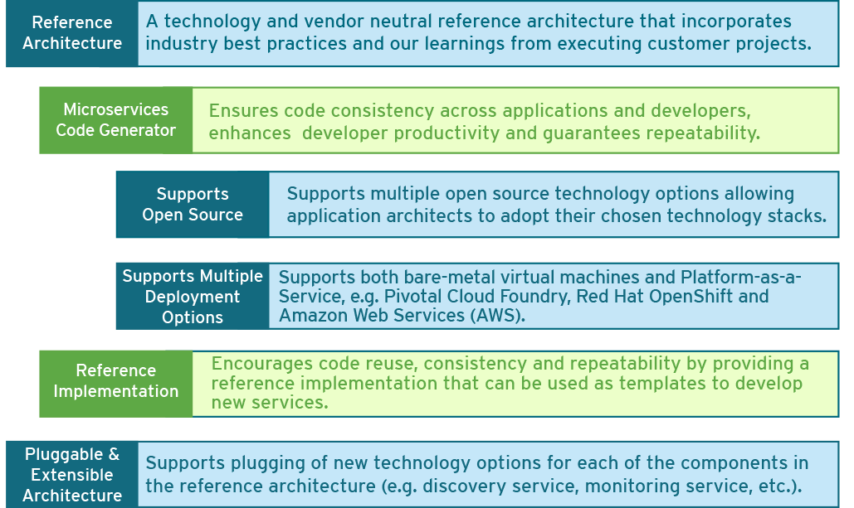
Cognizant COSMOS – Benefits

Slide 15
Cognizant COSMOS Microservice Orchestration – Building Blocks
WORKFLOWS
consist of
TASKS
SYSTEM TASKS
FORK
SIMPLE TASKS
JOIN
deployed on
registered with
DECISION
implement
start
WAIT
ORCHESTRATION SERVER
poll and update
WORKERS
HTTP
registered
with
complete or terminate
EVENT
EVENT HANDLERS
listens to
MESSAGING INFRASTRUCTURE
publishes to
Notes:
Netflix Conductor Enhancements :
Registration of Orchestration Server in a Service Registry (Discovery Server). This helps clients locate the Orchestration Server without hardcoding the host and port information
Registration of Worker Task nodes in a Service Registry (Discovery Server). This helps monitoring the status of the nodes
By default, if a Worker Task node crashes after acknowledging a task, there is no way to reschedule the task unless the task is manually restarted by the Orchestration Server. Our enhancement makes it possible to persist the task information, so that in case of a node failure, the task can be rescheduled automatically without manual intervention
Netflix Conductor supports publishing events to AWS SQS and Dynomite Queue. Our enhancement allows publishing events to any JMS broker as well. Currently, Apche ActiveMQ is supported
Netflix Conductor supports Event Handler registration for AWS SQS and Dynomite Queue. Our enhancement allows listening to Apache ActiveMQ queues and topics (for starting a workflow and completing or terminating a task)

Slide 16
Cognizant COSMOS Case Study – Large European Telecom Service Provider
Background and Challenges
Solution Offered
Key Benefits
Corporate customer proposal and contract management process distributed across different applications
Manual workflows with human interventions necessary across activities
Lack of end to end business process visibility with data captured in different applications leading to incomplete view of the contract management process
Slow roll-out of new features and modifications impacting business’ need to react to industry changes with agility
A Microservices Application Architecture was proposed using Apache Camel & Spring Cloud based technology stack
Generated all infrastructure and business microservices scaffold code using COSMOS
Leveraged reusable Docker templates from COSMOS to create deployable packages of both infra and business services
Leveraged reusable COSMOS components, clients and connectors to accelerate the delivery process
Over 80% reduction in application architecting effort by leveraging COSMOS’ Microservices Reference Architecture
Enforcing consistent coding practice and rapid onboarding of developers through use of COSMOS libraries and coding accelerators
About 60-70% reduction in development effort by leveraging the configurable infra and foundational service components supported by COSMOS

Slide 17
Cognizant COSMOS 2.0 – Key Features
Application architecture using controller-service-data access pattern
Define the API model by importing Swagger 2.0 file
Model REST API using built-in resource archetypes
Configurable validation rules for resource model
Automated mapping of entity objects and resource objects at runtime
Source code generation for microservices from the API model
Configure composite services using relevant interaction patterns
DAO implementation using Spring JDBC or Spring JPA
Generates JPA Entity and Repository classes from database schema
OAuth2.0 support using Spring Security
Exception handling at application tiers
Executable test case generation for core services

